Slide 1

FRAUD TRANSACTION DETECTION
A system that can classify if a transaction is fraudulent or not
Internship ID: UMIP272882 Name: Yashwanth Reddy Kuchipudi

Slide 2
Dataset Description
This dataset is a simulated dataset of original and fraudulent transactions, and only has the
main core details of a transaction.
Description of main columns:
TRANSACTION_ID: A unique identifier for the transaction
TX_DATETIME: Date and time at which the transaction occurs
CUSTOMER_ID: The identifier for the customer. Each customer has a unique identifier
TERMINAL_ID: The identifier for the merchant (or more precisely the terminal). Each
terminal has a unique identifier
TX_AMOUNT: The amount of the transaction.
TX_FRAUD: A binary variable, with the value 0 for a legitimate transaction, 1 for a
fraudulent transaction.

Slide 3
Approach
Exploration of dataset
Data Preprocessing
Creation of new features based on the scenarios given in the problem statement
Train- Test dataset split
XGBClassifier model initialization and training
Probabilities & Predictions
Results of classification report and AUC-ROC score with ROC curve

Slide 4
Exploration of dataset
The data was initially given in the form of .pkl files. So for exploring it, we need to convert them into .csv or excel which would easy for us to get an idea about it and import for the model
After exploring the dataset, its quite clear that it’s a clean dataset without any Nan or null values.
But class imbalances can be observed when we can look through the sorted order of the result classes
Fraud Scenario | No of instances
1 | 589
2 | 5138
3 | 2720
No Fraud | 1040128

Slide 5
Data Preproccessing
Conversion of data & time to the correct format and sorting the dataset according to it to make the dataset in a chronological order
Making sure that the dataset does not contain any null or Nan values
Creation of new features
Based on the scenarios given in the problem statement, new columns or features are created in the dataset.
This is done to make use of them for the model training.

Slide 6
Dataset split
The entire dataset was categorized into train data and test data.
Most commonly, 80-20 or 75-25 percentage is followed for the dataset split. I opted for 80-20.
To be more specific, first 146 days of transaction records are considered for training and the rest 37 days is taken as test data.

Slide 7
XGBClassifier model
The XGBoost Classifier (XGBClassifier) was chosen due to its efficiency with tabular data and its ability to handle imbalanced datasets.
eval_metric="aucpr" was used — the model focuses on minimizing the negative log-likelihood essentially optimizing how confident the model is about its probability predictions. This is great for imbalanced datasets like fraud detection since it penalizes wrong confident predictions more heavily.

Slide 8
Model improvement
Techniques like Hyperparameter tuning and SMOTE analysis were done on the model but resulted in lower F1-scores

Slide 9
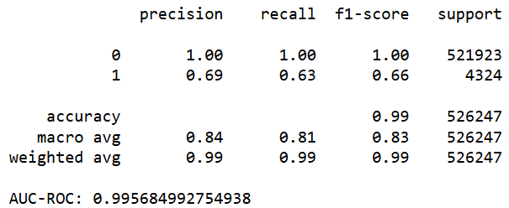
Classification Results
Classification Report and AUC-ROC score:
All transactions predicted as non-fraud are correct.
F1-Score: 0.66 — Reflects the balance between precision and recall, this suggests the model can identify fraud but with a moderate level of accuracy.
Accuracy: 0.99 — Very high, but given the class imbalance, but there’s still a gap in fraud detection performance.
AUC-ROC Score: 0.996 — Extremely high, indicating the model is very good at distinguishing between fraud and non-fraud cases overall.

Slide 10
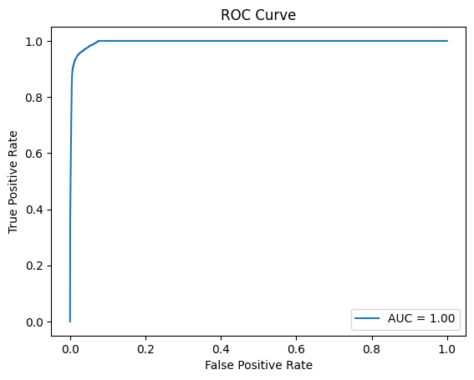
Classification Results
The curve is close to the top left corner, indicating strong performance, but the slight gap from the top means there's still potential to enhance fraud detection (Class 1).

